Slide 1

Huazhong University of Science and Technology
The Department of Electronics and Information Engineering
Electronic Circuit Analysis and Design
Dr. Tianping Deng
Email: dengtp@hust.edu.cn

Slide 2
Contents
PART 1 SEMICONDUCTOR DEVICES AND BASIC APPLICATIONS
Chapter 1 Semiconductor Materials and Diodes
Chapter 2 Diode Circuits
Chapter 3 The Field-Effect Transistor
Chapter 4 Basic FET Amplifiers
Chapter 5 The Bipolar Junction Transistor
Chapter 6 Basic BJT Amplifiers
Chapter 7 Frequency Response
Chapter 8 Output Stages and Power Amplifiers
PART 2 ANALOG ELECTRONICS
Chapter 9 Ideal Operational Amplifiers and Op-Amp Circuits
Chapter 10 Integrated Circuit Biasing and Active Loads
Chapter 11 Differential and Multistage Amplifiers
Chapter 12 Feedback and Stability
Chapter 13 Operational Amplifier Circuits
Chapter 14 Nonideal Effects in Operational Amplifier Circuits
Chapter 15 Applications and Design of Integrated Circuits
Chapter 2 Diode Circuits

Slide 3
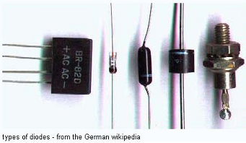
Ch2. Diode Circuits
2.1 Rectifier Circuits
2.2 Zener Diode Circuits
2.3 Clipper and Clamper Circuits
2.4 Multiple-Diode Circuits
2.5 Photodiode and LED Circuits
2.6 Design Application: DC Power Supply
2.7 Summary

Slide 4
Ch2. Diode Circuits
2.0 Preview
The process, which a circuit accepts an input signal at a set of input terminals and produces an output signal at a set of output terminals is called signal processing.
circuit
input signal
signal
processing
output signal

Slide 5
Ch2. Diode Circuits
2.0 Preview
The circuit “processes” the input signal and produces an output signal that is a different shape or a different function compared to the input signal.
circuit
input signal
signal
processing
output signal
Circuits composing of the pn junction diodes perform functions such as rectification, clipping, and clamping.

Slide 6
In this chapter, we will:
Determine the operation and characteristics of diode rectifier circuits, which is the first stage of the process of converting an ac signal into a dc signal in the electronic power supply.
Apply the characteristics of the Zener diode to a Zener diode voltage regulator circuit.
Apply the nonlinear characteristics of diodes to create waveshaping circuits known as clippers and clampers.
Examine the techniques used to analyze circuits that contain more than one diode.

Slide 7


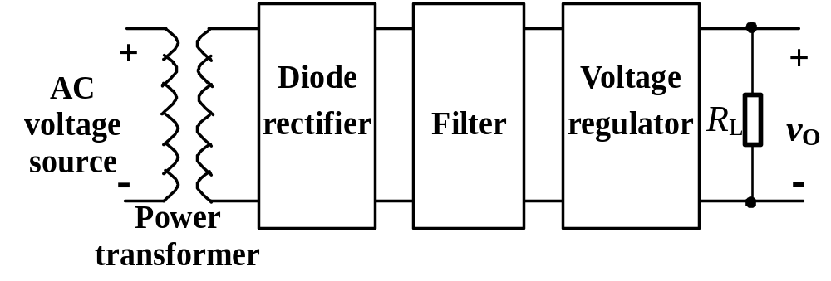
2.1 Rectifier Circuits
Rectification is the process of converting AC voltage into one that is limited to one polarity.
AC
DC
Rectification is classified as half-wave or full-wave.
Block diagram of an electronic power supply

Slide 8
DC
AC
DC

Slide 9

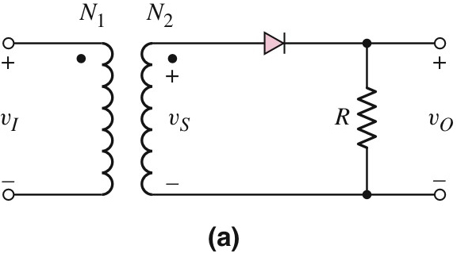
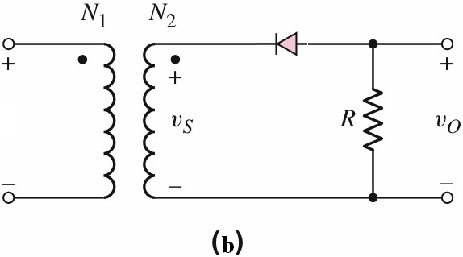
Ideal model
Linear Approximation Case1

Slide 10
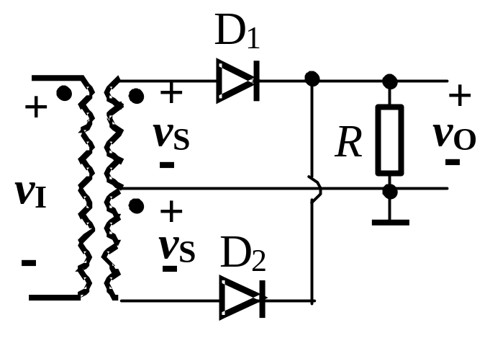
Ideal model
Linear Approximation Case1

Slide 11
T
D₄
u₁
R_{L}
u₂
D₁
D₃
u_{o}
D₂
Ideal model
Linear Approximation Case1

Slide 12
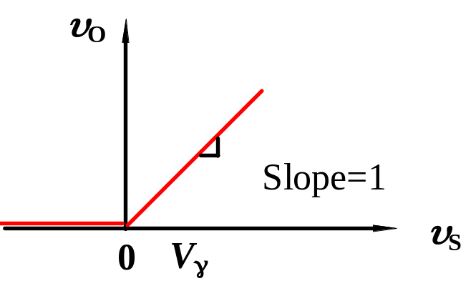
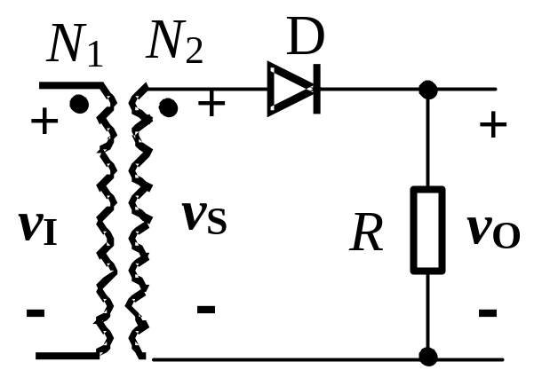
2.1.1 Half-Wave Rectification
Structure: a power transformer + a diode + a resister
Assume: r_{f} =0 , and the diode is ideal,
v_{S} < 0 ,
diode is “off”,
v_{D}= v_{S} , v_{O}=0.
v_{S} > 0 ,
diode is “on”,
v_{D}= 0 , v_{O}= v_{S} .
-
+
Half-wave rectifier
Voltage transfer characteristics

Slide 13
v₁ is a sinusoidal signal
v_{i}
wt
v_{o}
wt

Slide 14
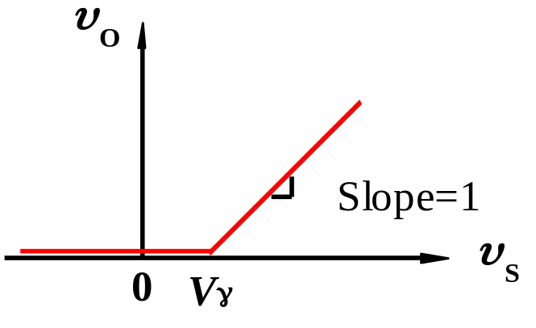
2.1.1 Half-Wave Rectification
Structure: a power transformer + a diode + a resister
Assume: r_{f} =0 , using the piecewise model case 1
v_{S} < V_{r} ,
diode is “off”,
v_{D}= v_{S} , v_{O}=0.
v_{S} > V_{r} ,
diode is “on”,
v_{D}= V_{r} , v_{O}= v_{S} – V_{r} .
Voltage transfer characteristics
Half-wave rectifier

Slide 15
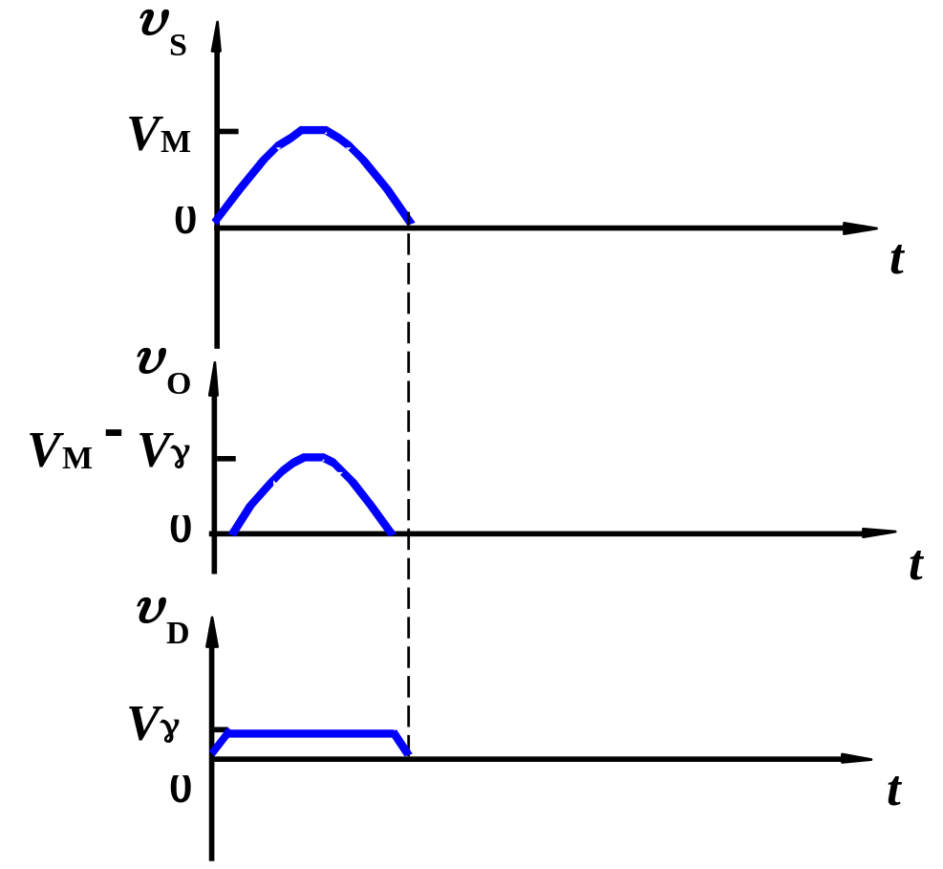
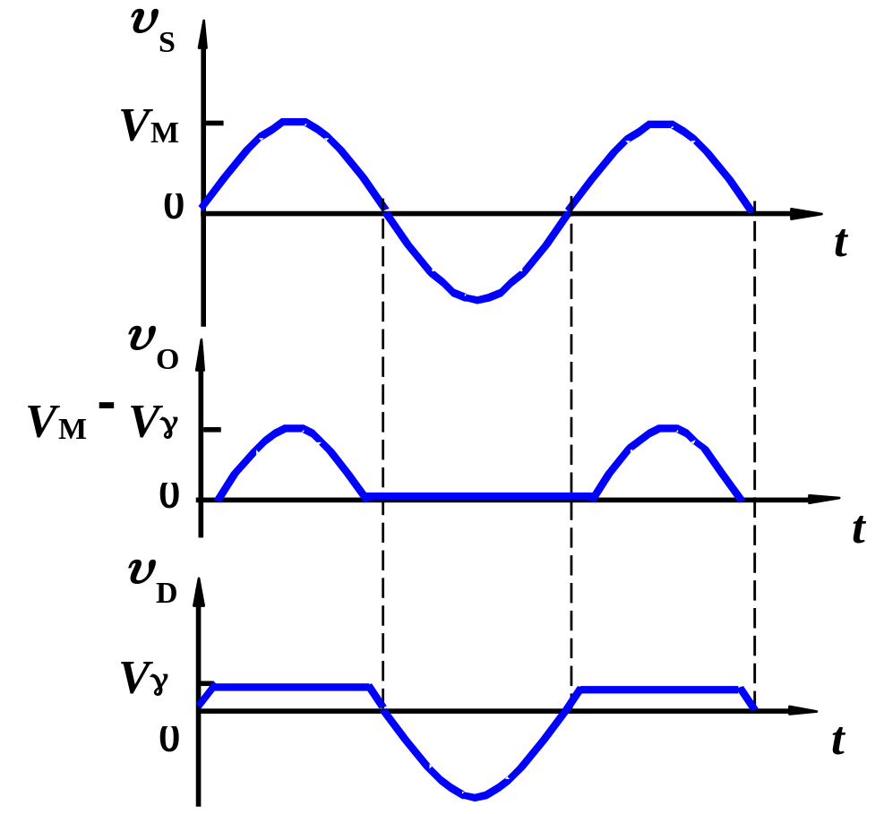
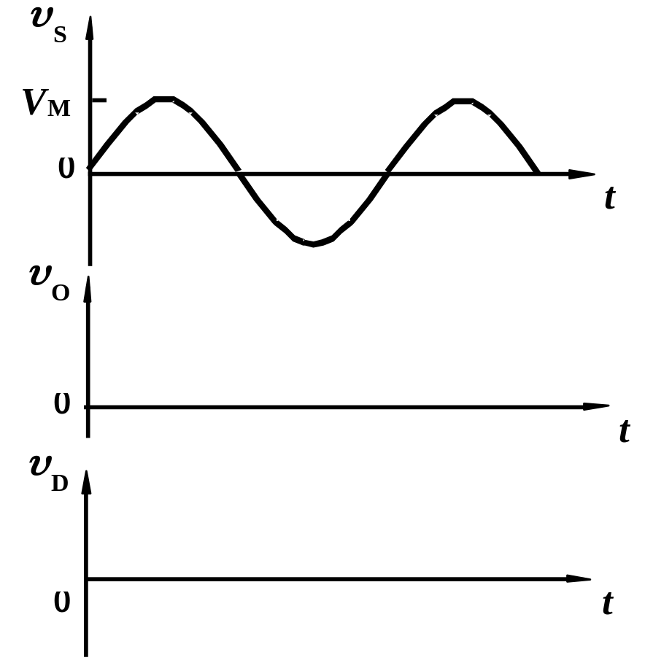
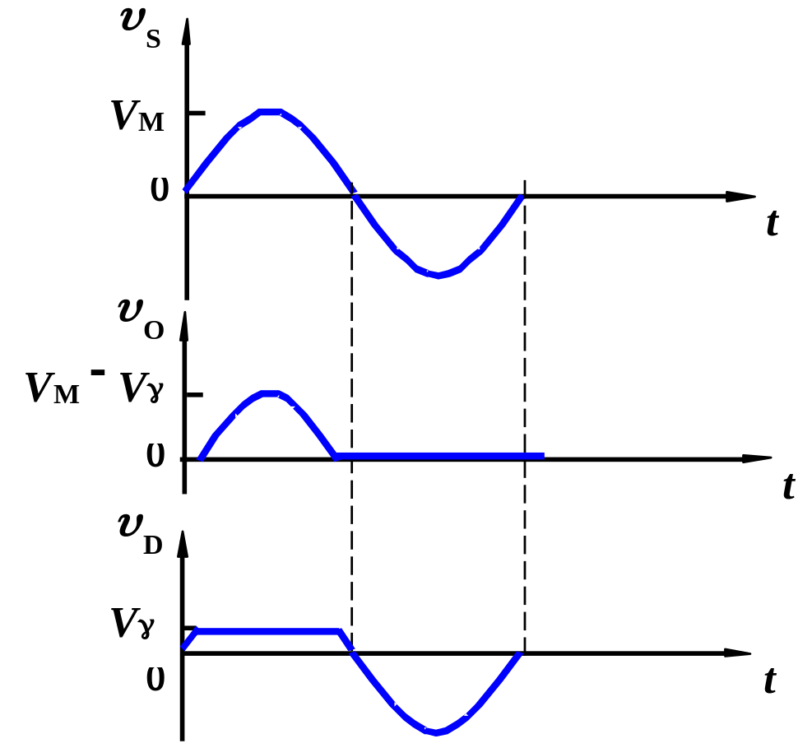
2.1.1 Half-Wave Rectification
v_{S} is a sinusoidal signal
(1) v_{S} > V_{r} , D is “on”,
v_{D}= V_{r} , v_{O}= v_{S} – V_{r}.
(2) v_{S} ≤ V_{r} , D is “off”, v_{D}= v_{S} , v_{O}=0.
Input and output waveforms
Half-wave rectifier

Slide 16
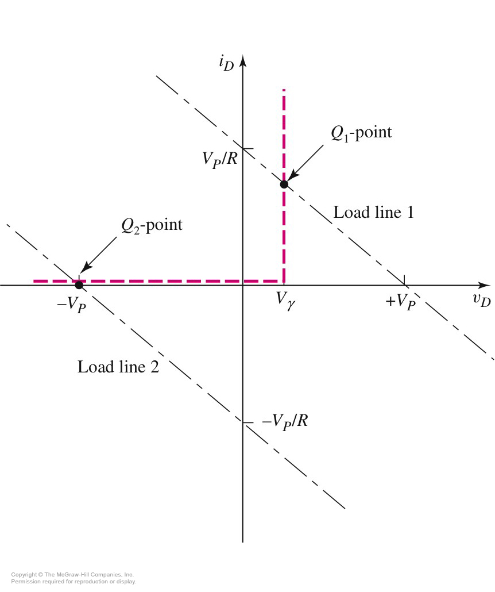
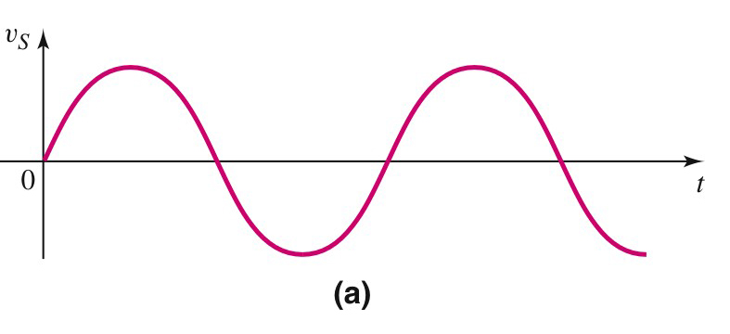
2.1.1 Half-Wave Rectification
Load line when v_{S} is at its maximum forward voltage.
v_{S}＝v_{D}＋i_{D}R
Load line
Load line when v_{S} is at its most negative value.

Slide 17
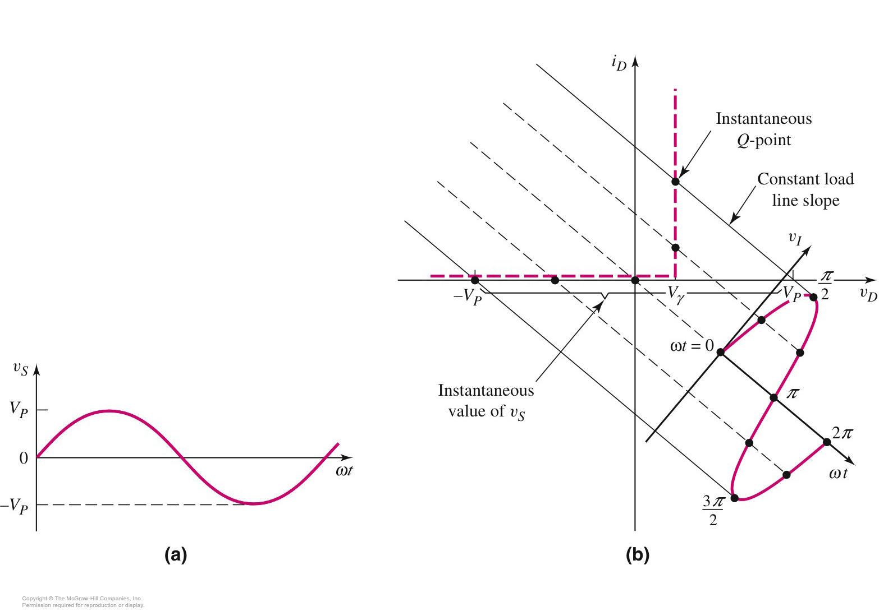
2.1.1 Half-Wave Rectification
v_{S}＝v_{D}＋i_{D}R

Slide 18

2.1.1 Half-Wave Rectification

Slide 19
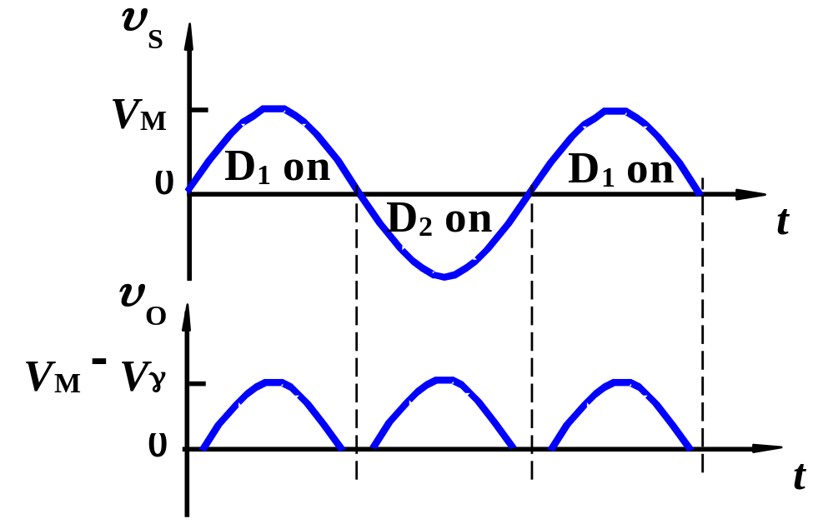
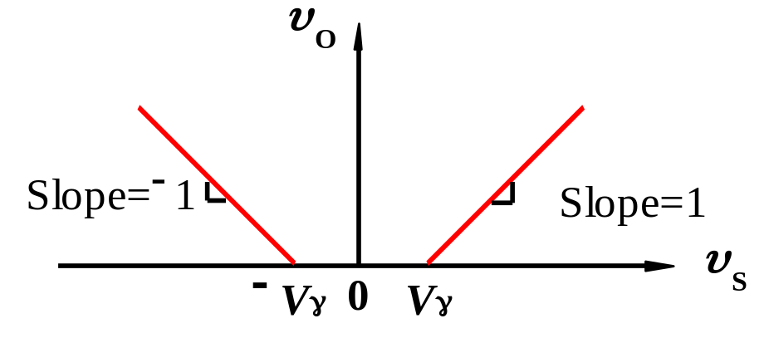
2.1.2 Full-Wave Rectification
1. Rectifier with
center-tapped transformer
v_{S} > V_{r} ,
D₁ “on”, D₂ “off”
v_{O}= v_{S} – V_{r}
Full-wave rectifier
Full-wave rectifier
v_{S} < – V_{r} ,
D₂ “on”, D₁ “off”.
v_{O}= – v_{S} – V_{r}
– V_{r} ≤ v_{S} ≤V_{r} ,
D₁ and D₂ “off”.
v_{O}= 0
Voltage transfer characteristics
Input and output waveforms

Slide 20
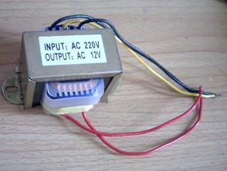
center-tapped transformer

Slide 21
2.1.2 Full-Wave Rectification
2. Bridge rectifier
T
D₄
u₁
R_{L}
u₂
D₁
D₃
u_{o}
D₂
Assume the diode is ideal

Slide 22
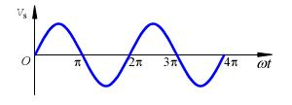
+
D₄
D₁
i_{o}
+
u_{o}
−
+
u
−
~
R_{L}
–
D₃
D₂
D₁ and D₃ “on”, D₂ and D₄ “off”

Slide 23
–
D₄
D₁
i_{o}
+
u
−
+
u_{o}
−
~
R_{L}
+
D₃
D₂
D₁ and D₃ “off”, D₂ and D₄ “on”

Slide 24
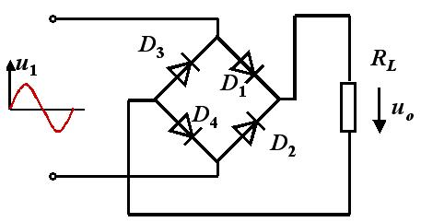
u₂
ωt
0
π
2π
3π
4π
u_{o}

Slide 25
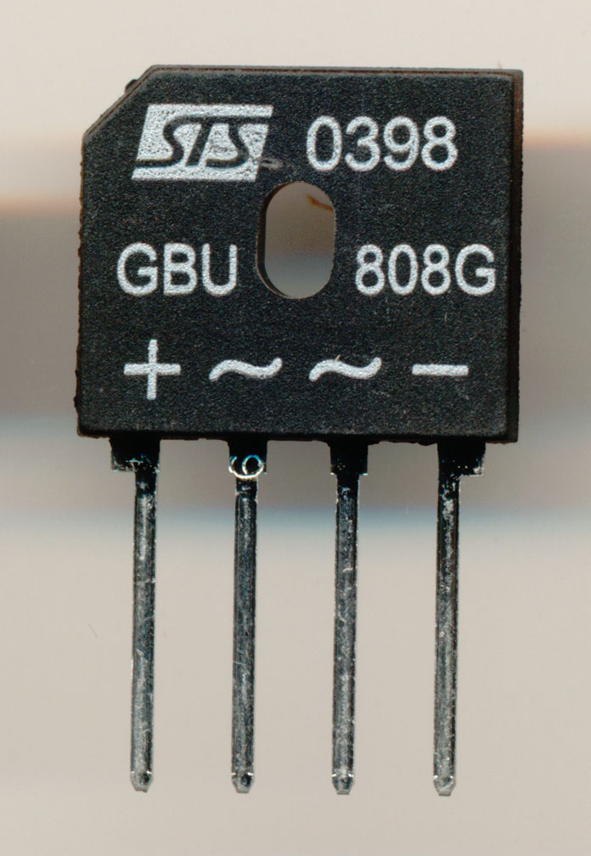
Rectifier bridge

Slide 26
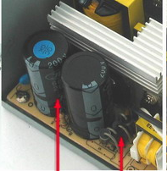

Slide 27
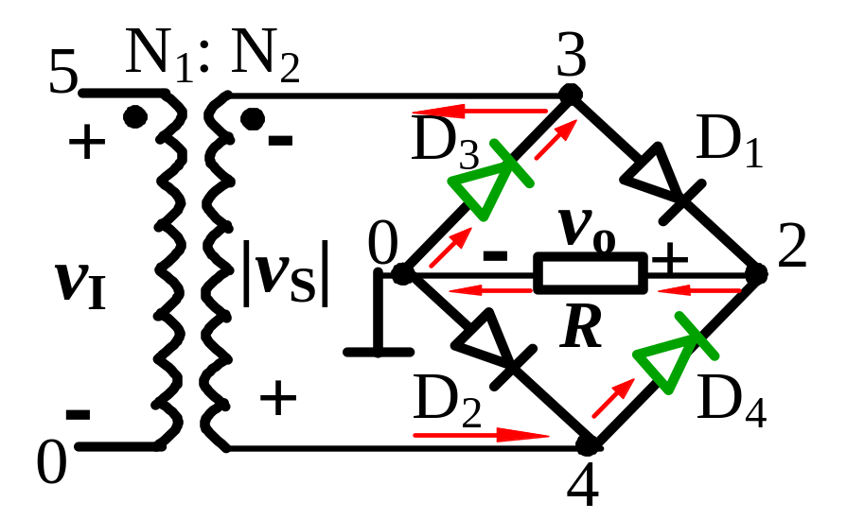
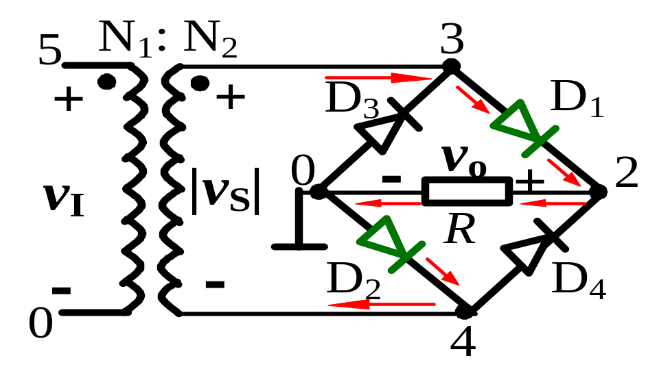
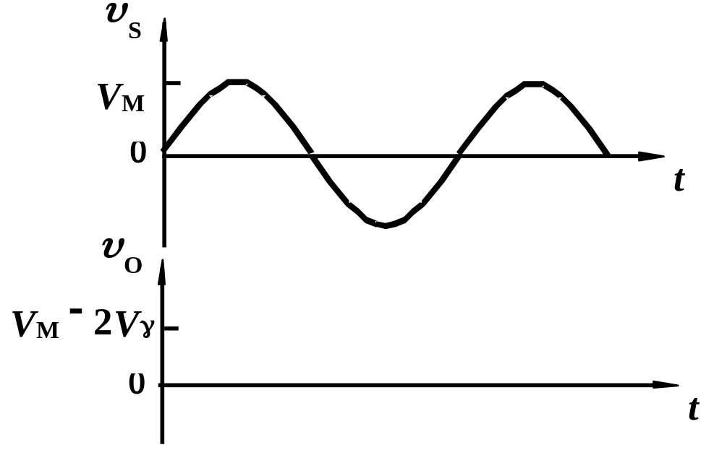
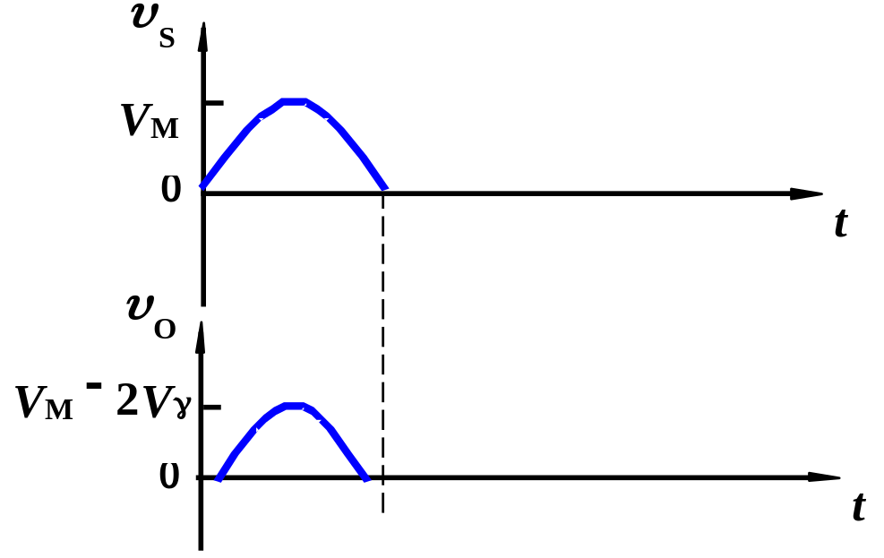
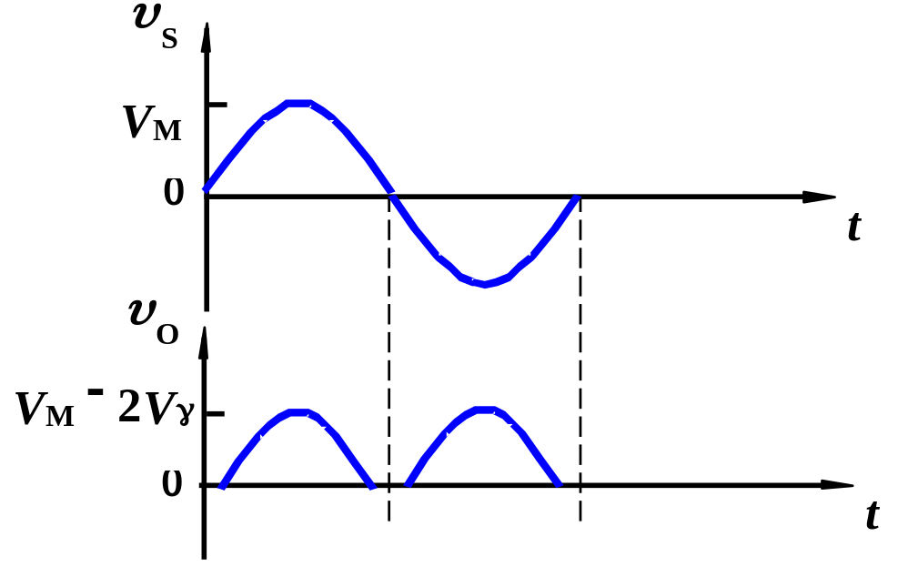
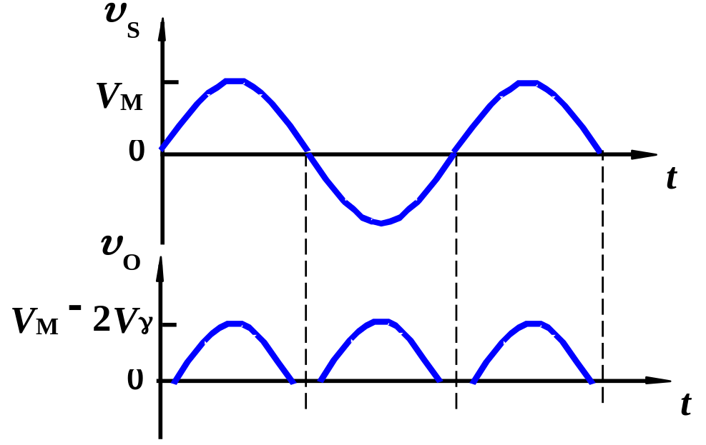
2.1.2 Full-Wave Rectification
2. Bridge rectifier
piecewise model case 1
v_{S} > 2V_{r} , D₁, D₂ “on”
v_{O}= v_{S} – 2V_{r}
v_{S} < – 2V_{r} , D₃, D₄ “on”
v_{O}= – v_{S} – 2V_{r}
– 2V_{r} ≤ v_{S} ≤2V_{r} ,
D₁ to D₄ all “off”.
v_{O}= 0
Input and output waveforms

Slide 28
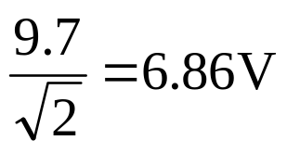
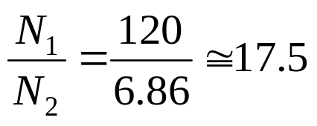
2.1.2 Full-Wave Rectification
E.g.2.1
Compare voltages and the transformer turns ratio in two full-wave rectifier circuits. Assume input 120V(rms), 60Hz ac source. v_{Omax}= 9V, V_{r} = 0.7V
Sol: For the center-tapped transformer circuit
v_{S(max)} = v_{O(max)} + V_{r} =9+0.7=9.7V
v_{S,rms} =
Turn ratio of primary to each secondary winding
The peak inverse voltage (PIV) of a diode is
PIV = 2v_{S(max)} –V_{r}=2×9.7 – 0.7=18.7V

Slide 29
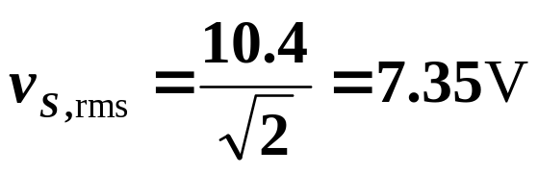
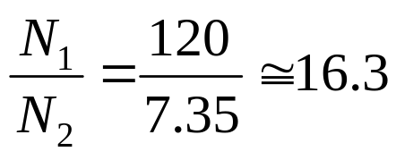
Sol: For the bridge rectifier
v_{S(max)} = v_{O(max)} + 2V_{r} =9+2×0.7=10.4V
Turn ratio should then be
The peak inverse voltage (PIV) of a diode is
PIV= v_{S(max)} –V_{r}=10.4 – 0.7=9.7V
Comment:
Only half of the secondary winding of the center-tapped transformer is utilized at any time.
The PIV of a diode in bridge circuit is only half that of the center-tapped transformer circuit.

Slide 30
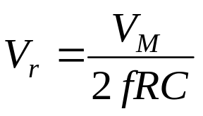
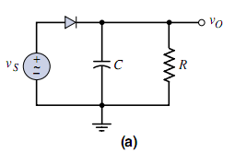
2.1.2 Filters, Ripple Voltage, and Diode Current
If a capacitor is added in parallel with the load resistor, it can transform the half-wave sinusoidal output into a dc voltage.
Ripple voltage is
V_{M} is peak value of output voltage.
The equation of diode current is in the page 72.

Slide 31
a
D₄
v₁
v₁
v₂
S
D₁
D₃
C
v_{L}
R_{L}
D₂
b

Slide 32
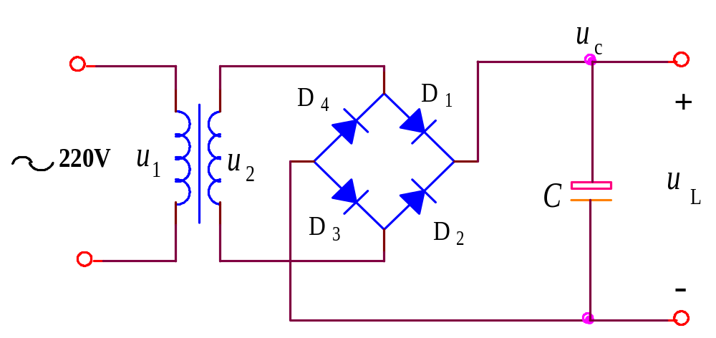
When R_{L}=∞:
u₂＞ u_{C}：
D is on，C is charging
u₂
t
u₂＜ u_{C}：
D is off，C is discharging。
But R_{L}=∞，there is no discharge circuit。
u_{c}=u_{L}
u_{L}
t

Slide 33
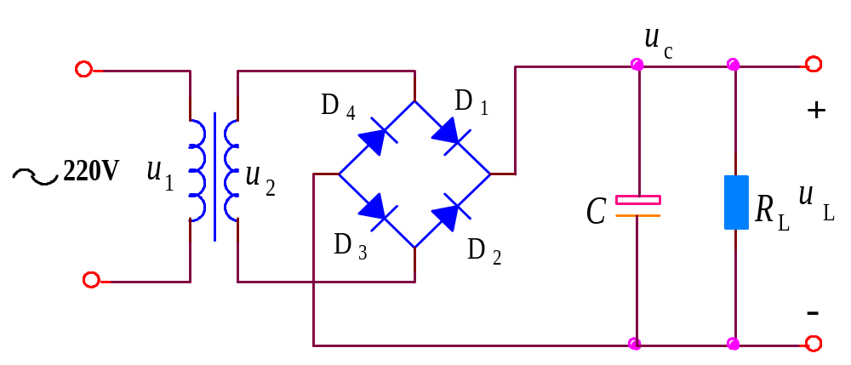
When R_{L}≠∞, and R_{L}C is very big:
u_{c}= u_{L}
u₂
u₂＞ u_{C}：
D is on，C is charging
t
u₂＜ u_{C}：
D is off，C is discharging
i_{D}
diode
current
t

Slide 34
Homework：P113 2.14

Slide 35
Questions
and
Answers

